Slide 1

Maps and Dictionaries
© 2013 Goodrich, Tamassia, Goldwasser
Maps and Dictionaries
Notes:
Dictionaries

Slide 2

Maps
A map is a searchable collection of items that are key-value pairs
The main operations of a map are for searching, inserting, and deleting items
Multiple items with the same key are not allowed
Applications:
  address book
  student-record database
© 2013 Goodrich, Tamassia, Goldwasser
Maps and Dictionaries

Slide 3
Dictionaries
Python’s dict class is arguably the most significant data structure in the language.
  It represents an abstraction known as a dictionary in which unique keys are mapped to associated values.
Here, we use the term “dictionary” when specifically discussing Python’s dict class, and the term “map” when discussing the more general notion of the abstract data type.
© 2013 Goodrich, Tamassia, Goldwasser
Maps and Dictionaries

Slide 4

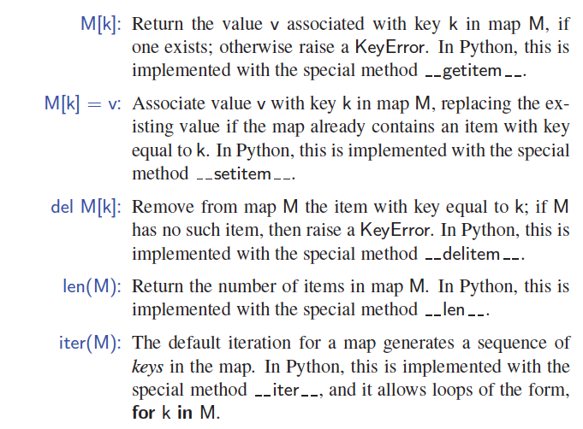
The Map ADT
(Using dict Syntax)
© 2013 Goodrich, Tamassia, Goldwasser
Maps and Dictionaries

Slide 5
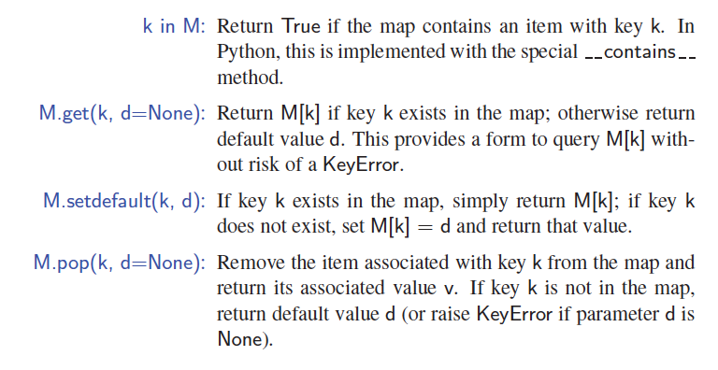
More Map Operations
© 2013 Goodrich, Tamassia, Goldwasser
Maps and Dictionaries

Slide 6
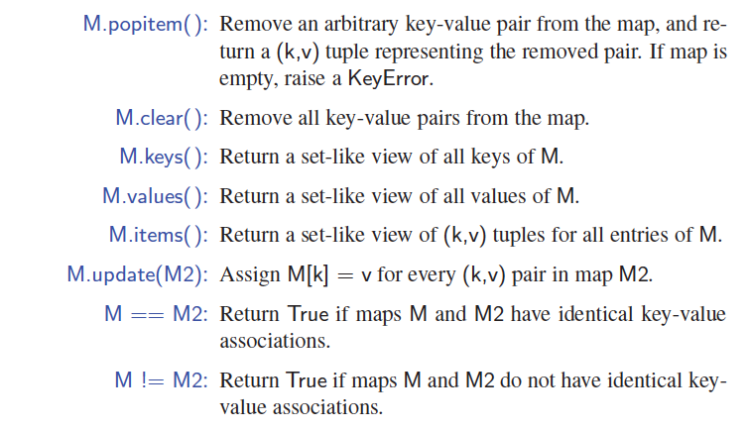
A Few More Map Operations
© 2013 Goodrich, Tamassia, Goldwasser
Maps and Dictionaries

Slide 7
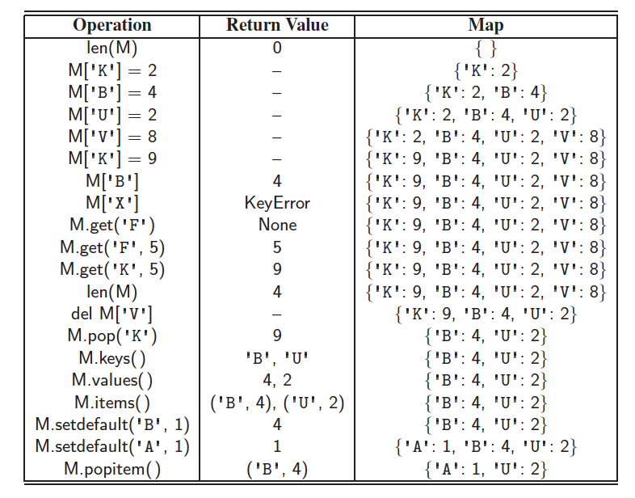
Example
© 2013 Goodrich, Tamassia, Goldwasser
Maps and Dictionaries

Slide 8
A Simple List-Based Map
We can efficiently implement a map using an unsorted list
  We store the items of the map in a list S (based on a doubly-linked list), in arbitrary order
header
nodes/positions
trailer
9
c
6
c
5
c
8
c
Items (key-value pairs)
© 2013 Goodrich, Tamassia, Goldwasser
Maps and Dictionaries

Slide 9
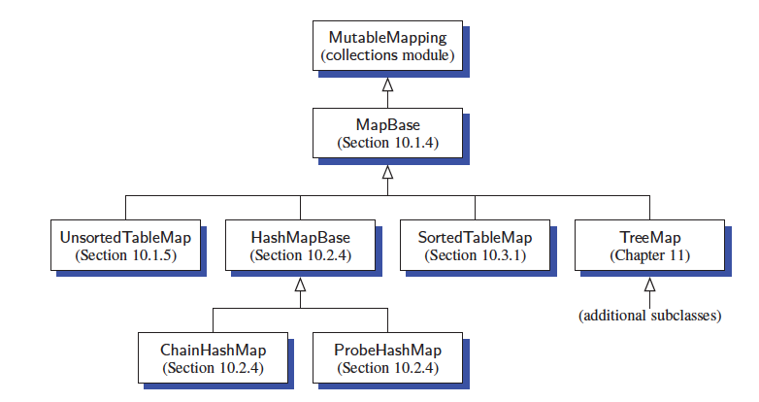
Our MapBase Class
© 2013 Goodrich, Tamassia, Goldwasser
Maps and Dictionaries

Slide 10
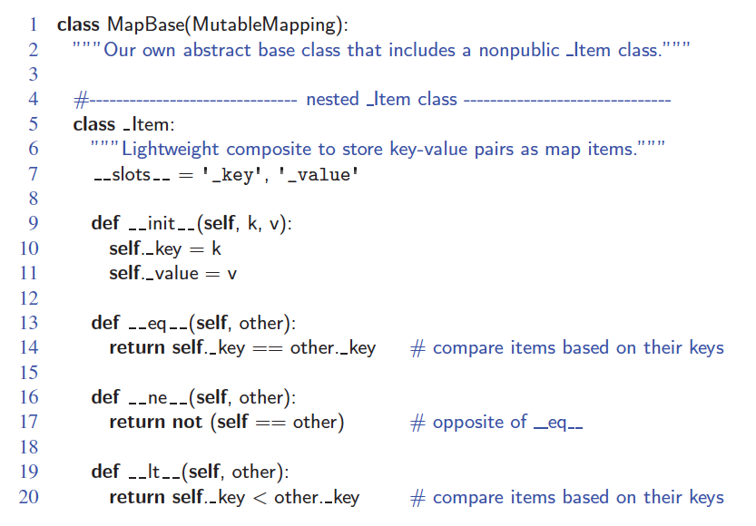
The MapBase Abstract Class
© 2013 Goodrich, Tamassia, Goldwasser
Maps and Dictionaries

Slide 11
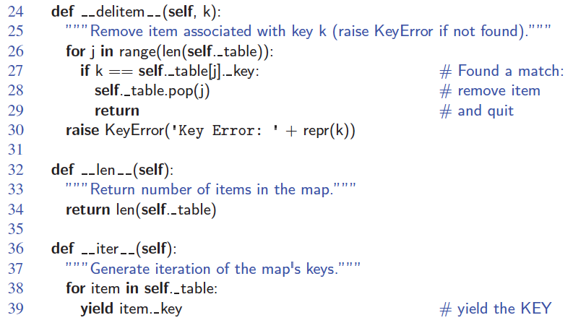
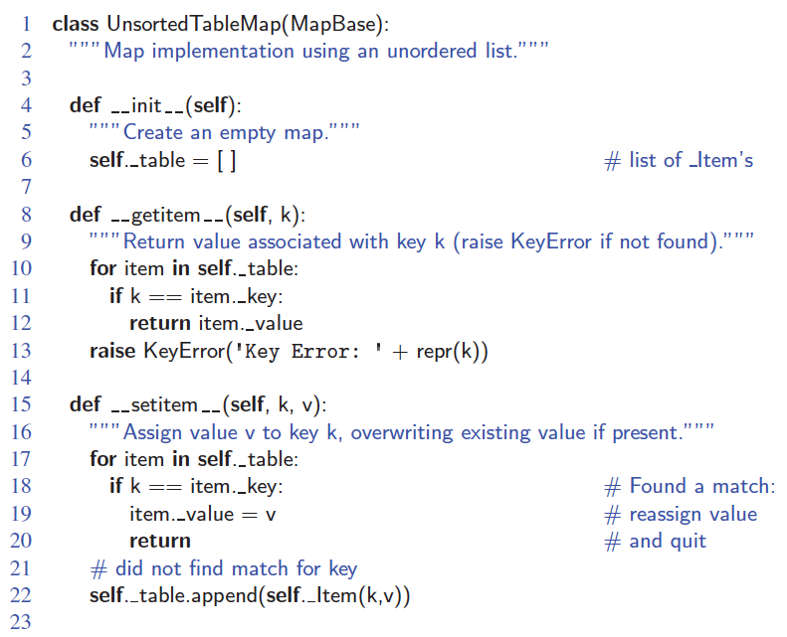
An Unsorted List Implementation
© 2013 Goodrich, Tamassia, Goldwasser
Maps and Dictionaries

Slide 12
Performance of a List-Based Map
Performance:
  Inserting an item takes O(1) time since we can insert the new item at the beginning or at the end of the unsorted list
  Searching for or removing an item takes O(n) time, since in the worst case (the item is not found) we traverse the entire listto look for an item with the given key
The unsorted list implementation is effective only for maps of small size or for maps in which insertions are the most common operations, while searches and removals are rarely performed (e.g., historical record of logins to a workstation)
© 2013 Goodrich, Tamassia, Goldwasser
Maps and Dictionaries

